Slide 1
Motor Operation Modes
Torque und Speed Controller

Slide 2
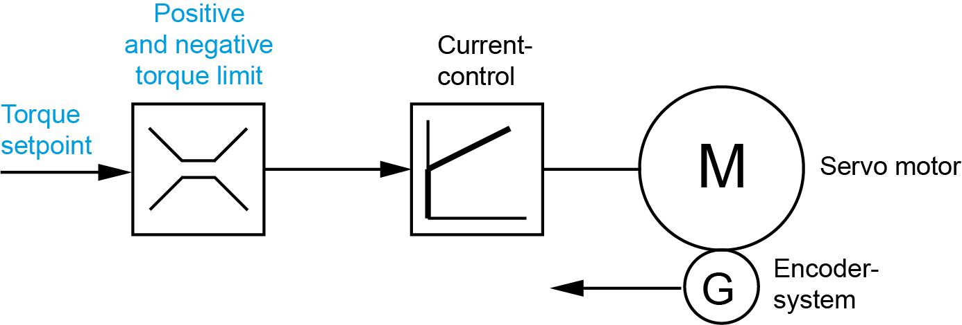
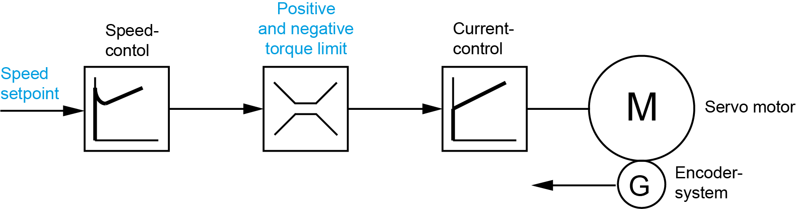

Operation Modes
Variant 1: Torque control
Variant 2: Torque control through torque limitation
+ dynamic speed limitation (included speed controller)
Required customer setpoints
Torque setpoint
Torque limitation
Required customer setpoints
Speed setpoint
Torque limitation
Advantage
The actual motor torque corresponds
to the customer's torque setpoint.
Advantage
Variable speed setpoints (limitation)
Disadvantage
If necessary, a speed limit must be made
on the customer control
Disadvantage
The motor torque is calculated by the AMKmotion
controller and can be smaller than the specified torque limit

Slide 3

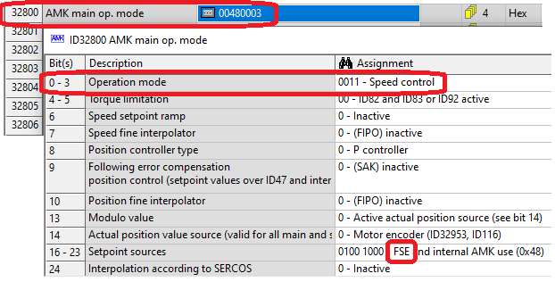
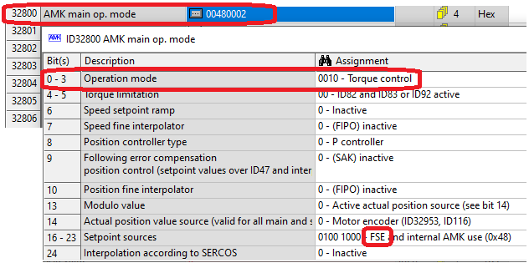
Parameterization Operation Modes
Torque control through torque limitation (+ dynamic speed limitation) (incl. speed controller)
Torque control (without speed controller)

Slide 4
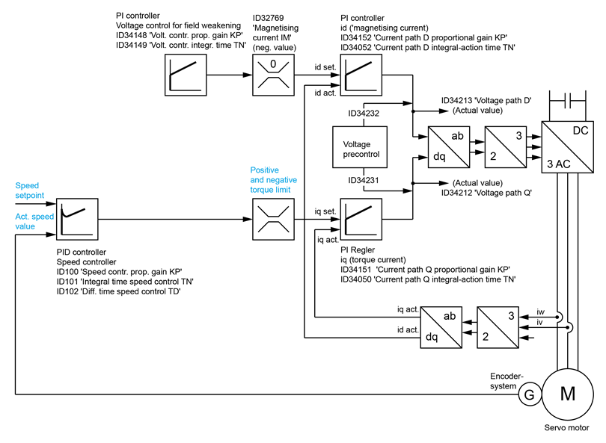
Over View Control Structure
control structure
field weakening
Speed
controller
Current
controller

Slide 5
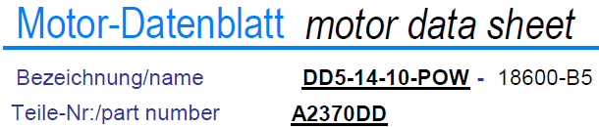
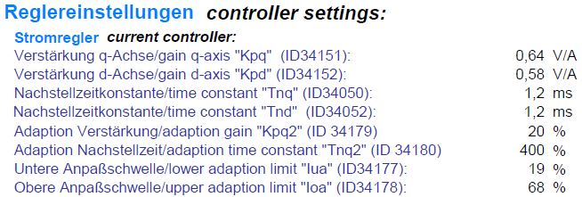

Current Controller
Values determined by AMK

Slide 6
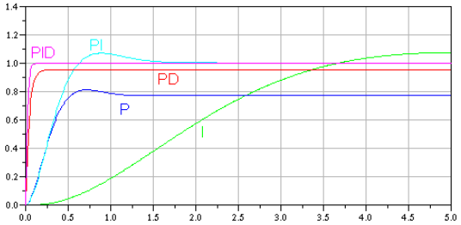
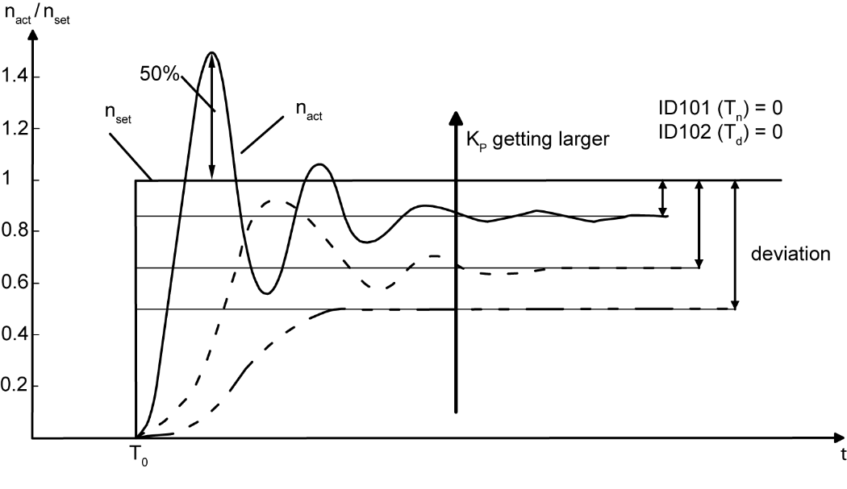
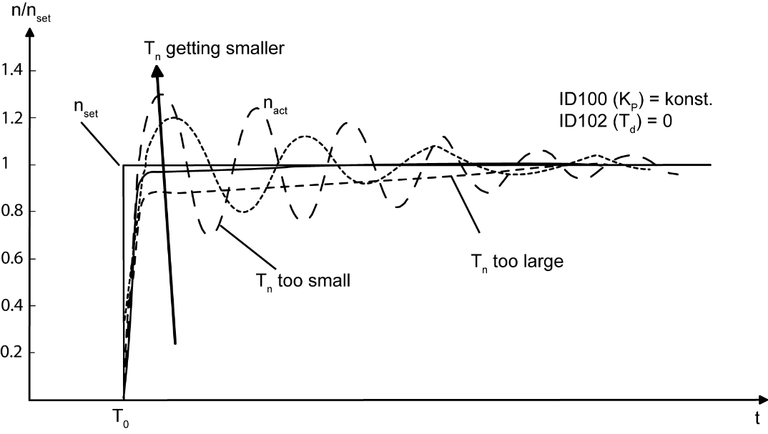
PID-Speed Controller
step response
time
Transfer function of the speed controller circuit,
effect ID100 'Speed control proportional gain KP' (KP)
Transfer function of the speed controller circuit,
effect ID101 'Integral-action time speed control TN' (Tn)

Slide 7
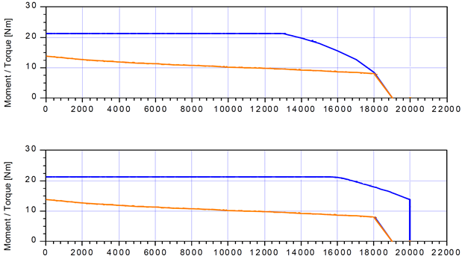
Relationship HV voltage between motor speed and torque
Torque curve at HV 500 VDC
max. motor torque
rated motor torque
Effect of battery voltage on maximum torque.
Example:
High Voltage 500 VDC or 600 VDC
3000 1/min longer maximum torque
3000
1/min
Torque curve at HV 600 VDC
max. motor torque
rated motor torque

Slide 8


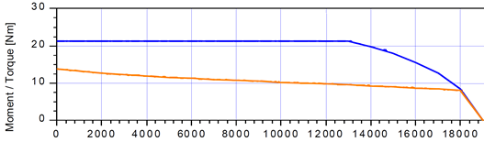
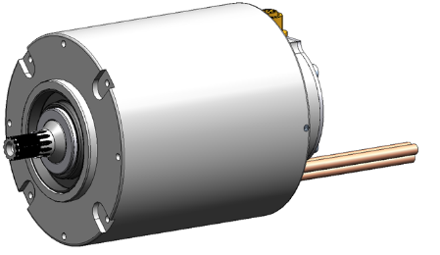
Relationship HV voltage between motor speed and torque
If the output voltage Us of the inverter is
mainly needed to counteract the induced voltage,
there is no voltage available to regulate
the Iq current (torque-forming current).
The torque-forming current decreases
and the motor speed cannot increase any further.
HV input voltage
… is limited by
the battery voltage
Inverter output voltage U_{s}
… is limited by
the HV voltage
(Iq)
Terminal
voltage
motor
The terminal voltage* at the motor increases with increasing speed.
* Induced voltage U_{p} (increases with increasing speed) + voltage drop at the winding.
The induced voltage U_{p} counteracts the output voltage Us.

Slide 9
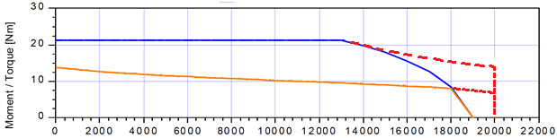
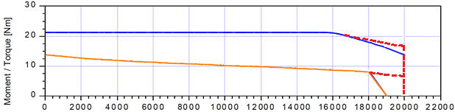
Operation with Field Weakening
- - - - Torque curve in field weakening
Torque curve at HV 500 VDC
A synchronous servo motor with field weakening
can reach higher speeds,
with simultaneously, only slowly reducing motor torque.
In addition, control reserves
in the area of the characteristic speed point are reached.
max. motor torque
rated motor torque
Torque curve at HV 600 VDC
The entry point into the field weakening shifts
depending on the HV voltage.
max. motor torque
rated motor torque

Slide 10
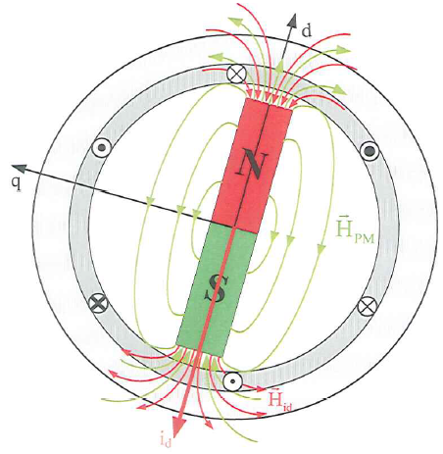

Operation with Field Weakening
Reminder:
The induced motor voltage U_{p} (increases with increasing speed)
counteracts the inverter output voltage U_{s}
and prevents the further increase of the speed.
i_{q} torque current
Field Weakening functionality
During field weakening, a negative magnetizing current i_{d} is impressed.
The field of the magnetizing current i_{d} counteracts the field of the permanent magnet.
The magnetic flux ψ is reduced, which also reduces the induced voltage.
As a result, the terminal voltage decreases.
This means that the inverter has voltage available again for control the Id current.
If the output voltage of the inverter remains constant, the output frequency (speed) can be increased.
The speed can increase further.
i_{d} magnetizing current
Disadvantage:
Additional power losses due to the magnetizing current i_{d}. Therefore, the torque current must be reduced in order not to overheat the motor.

